Slide 1
Alps technology
CSCS User Lab Day 2024
Maxime Martinasso, CSCS

Slide 2
Alps Technology in a nutshell
Architectural concept: network end points for resources
Heterogeneous infrastructure (Nvidia GPU, AMD GPU, x86, ARM,…)
Managed by a micro service architecture control plane (CSM/OpenCHAMI)
Slingshot network: performance and zone segregation
Distributed Alps (multiple geo-distributed infrastructure)
Versatile software-defined Cluster (vCluster) technology
Convergence Cloud and HPC
Multitenant infrastructure
Science as a Service concept with innovative resource access

Slide 3
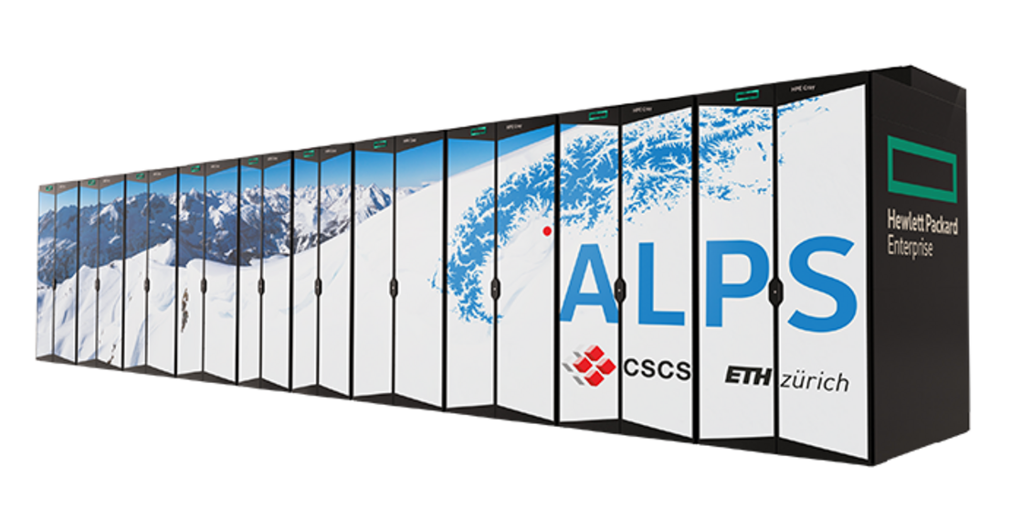
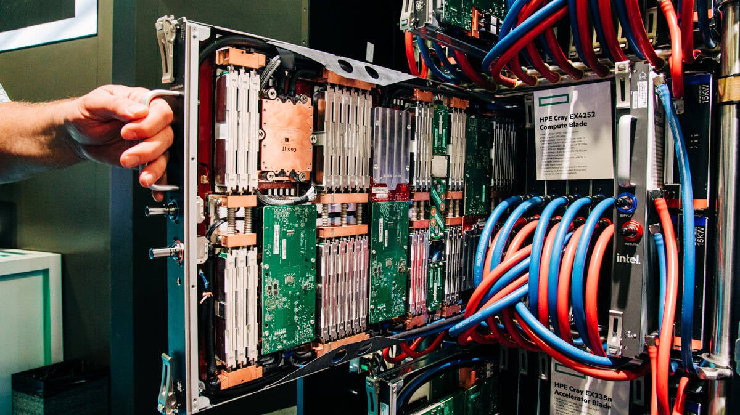
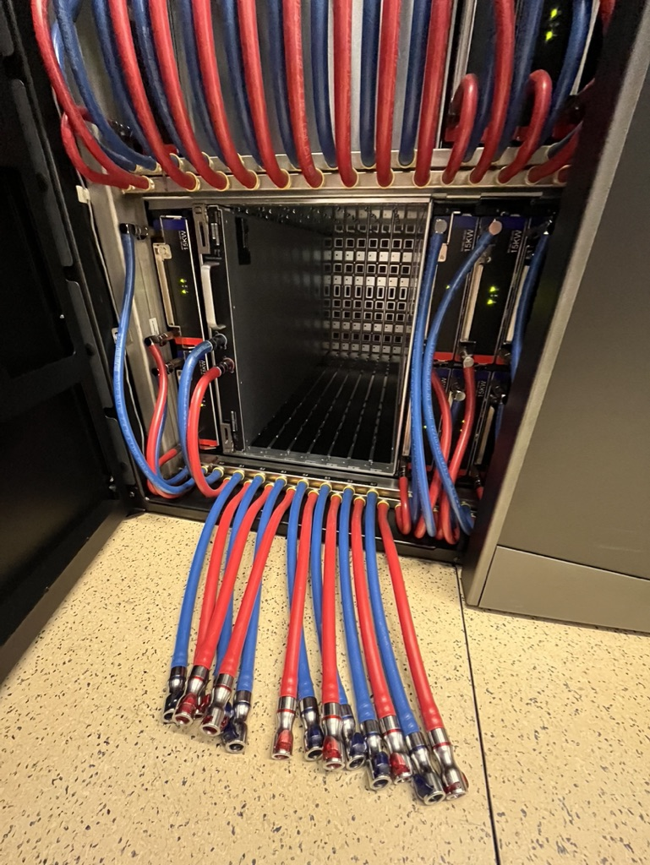
Alps Research Infrastructure
Alps is an HPE Cray EX supercomputer being our new flagship infrastructure
Some specs
1024 AMD Rome-7742 nodes 256/512GB
144 Nvidia A100 GPU nodes
24 AMD MI250x GPU nodes (LUMI1 type)
128 AMD MI300A GPU nodes (24Q4)
2688 Grace-Hopper nodes
Slingshot network (200 Gbps injection)
Two availability zones (HA, non-HA)
100% liquid cooled
100+10 PiB HDD
5+1 PiB SSD (RAID10)
100s of PiB tape library
~10 MW (envelope for power and cooling)
Inauguration of “Alps” – Open Day
Saturday 14th of September 2-5pm
LUGANO
Water cooled blades

Slide 4
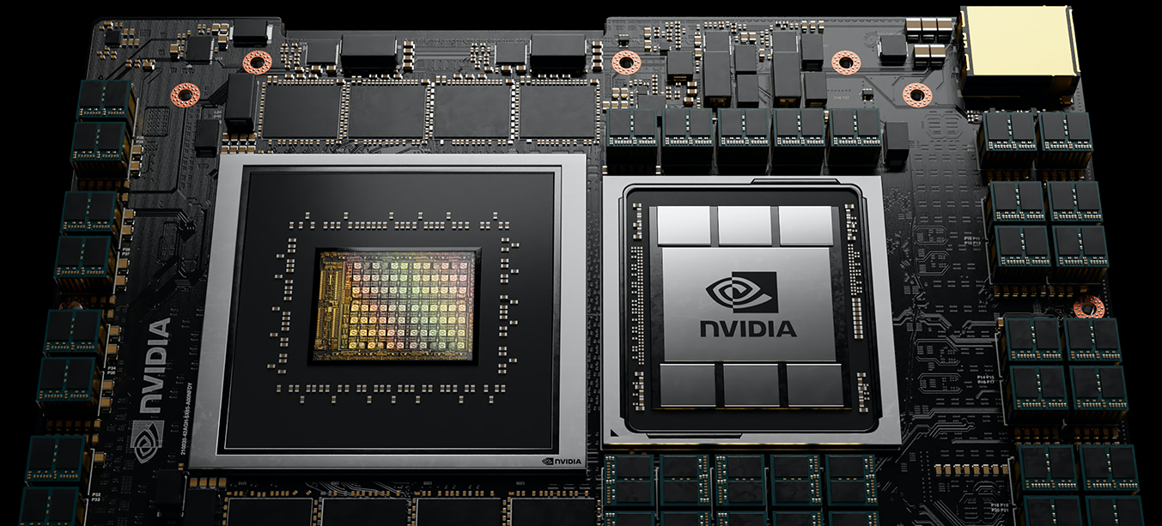
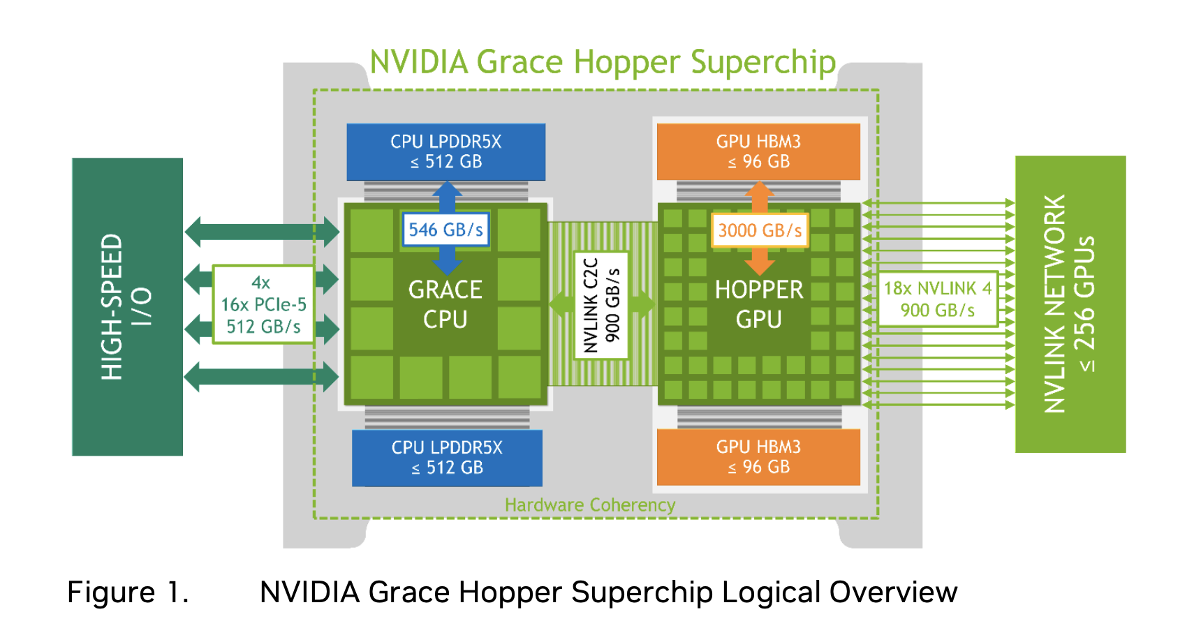
Grace-Hopper superchip (GH200)
Running and developing on Grace Hopper
Picture: NVIDIA Grace Hopper Superchip Architecture, page 7

Slide 5
Problem statements – more than an HPC infra

Slide 6
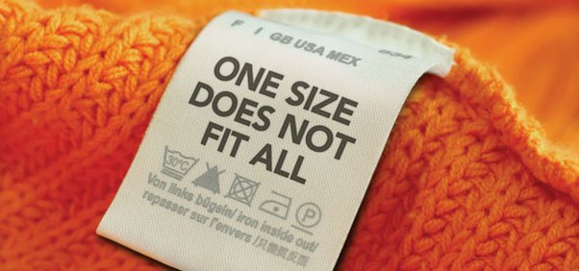
One-size-fits-all approach for HPC
HPC systems provide a vertically integrated stack
Flexibility of the programming env. is minimal
Composability of services is limited to few options
Upgrading means service disruption and forcing the rebuild of the entire upper stack
→ Separate community of users and provide them with custom services
- User Environments
- Services
- High-level library
- Low-level library
- OS
How to use and build HPC software at CSCS: a practical introduction

Slide 7
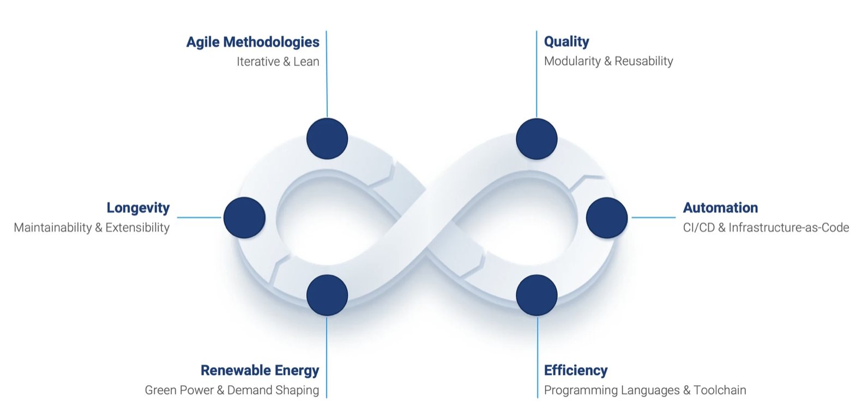
Sustainable software development
Scientific software have a longer lifespan than supercomputers
Code will be refactored to use latest hardware (accelerators) leading to costly scientific validation of outputs
Hardware heterogeneity + new programing env. lead to combinatorial number of tests
→ Adapt supercomputer services to application sustainability needs
Continuous Integration and Development for Scientific Applications

Slide 8

Movements of large datasets
Explosion of scientific data generation
Daily PB of data generated by high resolution simulations or scientific devices
Cost of data transfer, network distance between producer and consumer
→ Bridge compute and data together: select data, dedicated network link

Slide 9
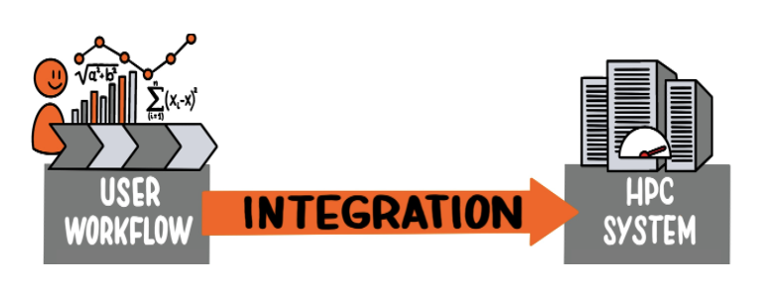
Flexible scientific workflows (1)
Simplify access to HPC resources for workflow to increase researcher efficiency
Need programmable interfaces to HPC resources
Bring your own software stack or user environments (example ML)
→ Use REST API and containers to facilitate scientific workflows
Automate your HPC workflows with FirecREST API and Sarus

Slide 10
Summary
Problem statements | Technology
One-size does not fit all | vCluster, OpenCHAMI, uenv
Sustainable software dev. | CI/CD, FirecREST, Sarus, ReFrame, vCluster
Large data sets | Distributed Alps, vCluster
Flexible scientific workflows | FirecREST, Sarus, vCluster

Slide 11
Alps technology - vCluster

Slide 12
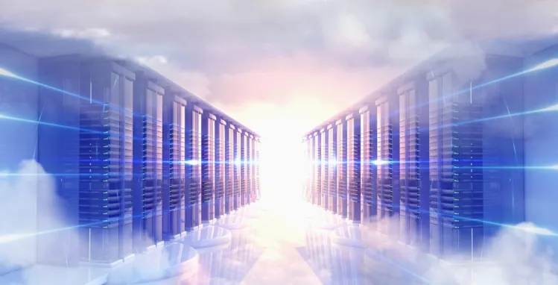
Versatile software-defined cluster vCluster technology
Concept of Cloud and HPC convergence
HPC: High performance ➔ vertically integrated stack ➔ limited set of services
Cloud: Virtualization at scale ➔ high flexibility ➔ limited performance
→ vCluster is a set of technologies to enable service flexibility on top of HPC

Slide 13
HPC and Cloud concepts to enable Science
Aim at Science as a Service
SSH / POSIX IAM
Defined by Business service
Cloud native IAM
Performance
OS drivers
Low-level library
High-level library
User Env for HPC
Layer flexibility
Infra as Code
Multi-tenancy: QoS and isolation
Software as a Service
User Env and Apps
Workflows and APIs
Access controls
Sci Apps and workflows
Business as a Service
- User Environments
- Services
- High-level library
- Low-level library
Platforms as a Service
Performance
Infrastructure as a Service
Virtualization
OS
OS
Bare metal
Bare metal
HPC
Cloud
Notes:
At CSCS our aim was to have convergence between
Maintain high-performance while having the flexibility to tailor the platform and service that we deliver to different partners on a single management plane or research infrastructure.
On the left we have the fully integrated sw stack in HPC
On the right we have the layered comoposition typical of the cloud
We have bare metal, virtualization then the three layers of IaaS, PaaS and BaaS
Business as a service is the product that is delivered to and used by the users
And we have authenticiation to provides access
We want to cherry pick and adapt these concepts to deliver more flexible HPC environments.
First, from HPC world we want to retain the high-performance aspects of HPC deployments
We spend a lot of money on highly specialized systems
Network and accelerators with optimized drivers and libraries configured for optimal perf.
Provide
Second, from the cloud world we want to take advantage of the flexibility of the cloud to start offering tailored solutions instead of requiring all communities to use a ”one-size-fits all” solution
To provide infra or platforms to users
This requires multi-tenancy, which is _not_ a given on the traditional HPC stack
We need APIs between layers
Infrastructure as code
On top of that we want to deliver services tailored to the different domains:
E.g. ML/Ai have different requirements and expectations from Climate modelling users
E.g. WLM manager customization, containersed service delivery, MPI vs NCCL, etc.
In the end the final goal is to have science as a service on HPC delivered to communities.

Slide 14

vCluster layers and tenant concept
User tailored environments
Programmable resource access
Scientific application build services
User environments services
Platform service engineer
Orchestration of platform services
Execution environments
Platform
Services management
Platform engineer
Interface to the management plane
Network segregation
Infrastructure provisioning
Infra admin
Notes:
Our objective is to implement these layers
they don’t exactly match those that you might expect in the cloud
1. First, we have an infrastructure layer
this might seem a bit odd at first, because we have installed a large HPC system as infrastructure on our machine room floor.
2. Second service management layer through which we can manage and orchestrate services much like in the cloud
3. Finally we have user environment services that imp0lement science as a service – the tools used directly by scientiests.
Starting with these concepts, let’s start digging into the roles associated with them
At the bottom, the role will be an infrastructure tenant admin
if you are the owner of the system, like CSCS, you are most likely to be the infra tenant.
But we can give some access to this layer to partners and institutions
To do that we need a very clean interface to the provisioning services
After that, if we do network segregation we have hard tenancy, where the resources really are in the hands of the external partner in terms of access
After that, once the resources have been partitioned we have service management.
if we do resource labelling at this level we have what we call a “soft tenant” and these resouces will be managed by CSCS, and run for the specific institution.
you can deploy services on top of it
there are two aspects of this
there is the orchestration of the services
the second is having everything possible running in containers – a container-first strategy. Felipe will be presenting this tomorrow after lunch
Then on top we have the user environment services that are tailored for and used by end users.
Programable resource access through firecrest allows us to build interfaces to HPC resources through the web or applications – no ssh required
We can deliver customized programming environments
Another example is providing publicly available CI/CD services that let users deploy software on the systems from GitHub/GitLab or Bitbucket repositories.

Slide 15
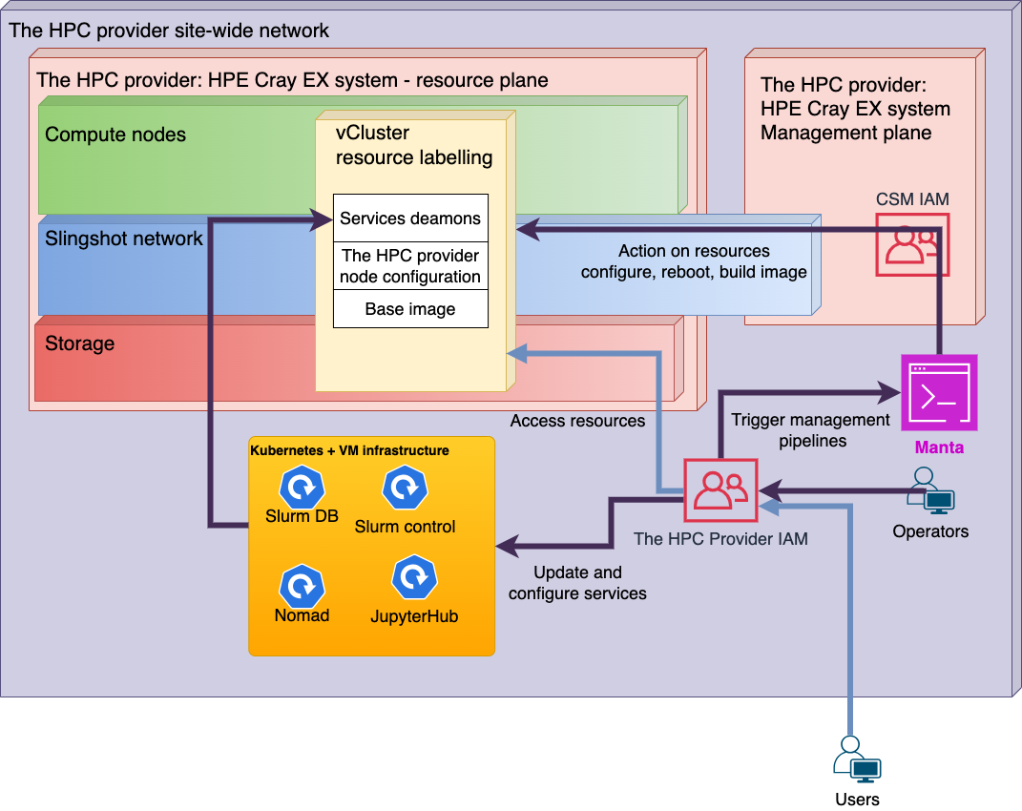
Notes:
Let’s have a more detailed look at the soft tenants operational view
This is a tennant for whom CSCS has deployed the infrastructure – they don’t manage the node images or operations like rebooting.
Everything is inside the CSCS site wide network.
On the right we have the management plane which manages the services on the resource plane
A resource labeling is used to assign the nodes to the tenant
CSCS provide the base image and network configuration
Some services that we might epect to be managed through CSM are provided on a separate k8s cluster
e.g. slurm controller, nomad, etc.
The tennent admin can use CSCS IAM to manage the system
through manta to access CSM – implements access control so that a platform tennent can only change the configuratiojn of certain nodes.
the tennent can also update the services, through pipelines
The tenant users has access to the resource plane
a subset of the compute nodes provided to the tennant
the network
storage (which can’t be partitioned yet, due to limitations of current HPC file systems)

Slide 16

Platforms and vClusters
Materials Cloud
Weather & Climate
WLCG
SKA
CTA
Merlin 7
Alps Infrastructure
Trad. HPC Platform (Daint)
ICON-22
ML
General information for working on Alps
ML and PyTorch in containers
Notes:
Let’s start with a view of some of the different platforms that are currently deployed on Alps.
We start with different platforms
Trad HPC, ML and W&C platform
ICON-22 is the MetteoSwiss platform for their operational and r&d vClusters
Merlin 7 is the only hard tennent currently on the system – for the PSI research center near Zurich
In the future there will be more
A platform can have multiple vClusters
E.g. MCH have one for r&d and one for production (operational daily forecasts)
E.g. one for deployment and a TDS for staging
E.g. the HPC platform will have one for batch jobs and one for interactive use cases (like Jupyter) where a subset of the resources on the node are assigned to a job
Personally I am excited about using this to let developers have access to a real HPC resource with their IDE, for which only 1/8 of a GPU might be required.
An infrastructure tennent has access to the management plane, i.e. CSM in our case
Allows them to perform actions like
Reboot nodes
Reconfigure nodes
A platform tennant is responsible for deploying the services on their platform
E.e. Swiss AI initative providing some container services, performing ticketing, etc.

Slide 17
On-going and future technology developments
vCluster and Alps in practice
On-going work to mature the technology
Multiple platform developments: HPC, ML, HTC,…
IaaS use cases in production
Data-bridges access and usage
Develop and increase adoptions of APIs for resource access and configuration
FirecREST, API Gateway, Sarus
CI/CD pipelines, user environment artefacts
Identify new technology opportunities to enhance our services
vCluster elasticity, on-demand storage, multi-interface data managers,
power-aware scheduling, zero-trust architecture, domain specific language and intermediate representation, DPU on network cards, LLM bots and user tickets,…

Slide 18
Thank you for your attention.

